Slide 1
Law

Slide 2
The focus of this evening
To inform you of the changes we have put in place to support our students and our expectations around these changes.
To engage you at the start of such an important academic year to help with your active involvement in supporting your children towards achieving successful outcomes.

Slide 3
Mocks
Year 13
Dates: 4th and 6th November
Paper 1 – 1hrs – The legal System/law making & Human Rights
Paper 2 – 1hrs – Criminal law & Tort law Year 12 and 13 Dates: End of Spring term
Paper 1 – 2hrs - The legal System & Criminal law
Paper 2 – 2hrs - Law making & The Tort of law
Paper 3 – 2hrs – Further law & the law of contract
A2 Paper
- Predicted grades

Slide 4
Exam style

Slide 6
Expectations
5 hours per subject outside of lesson time – make a timetable
2-3 hours of homework:
Timetable – Knowledge and essay. 1 x each per week.
Attend revision sessions and directed sessions
Reflect on marked work – respond to feedback and make improvements
Folders

Slide 7
What else should the student be doing at home?
Condensing information:
Making case cards
Revision cards
Posters/mind maps
Creating essay plans for each question
Practising past exam questions – perfect essay for each question
Improving work that has been marked below target

Slide 8
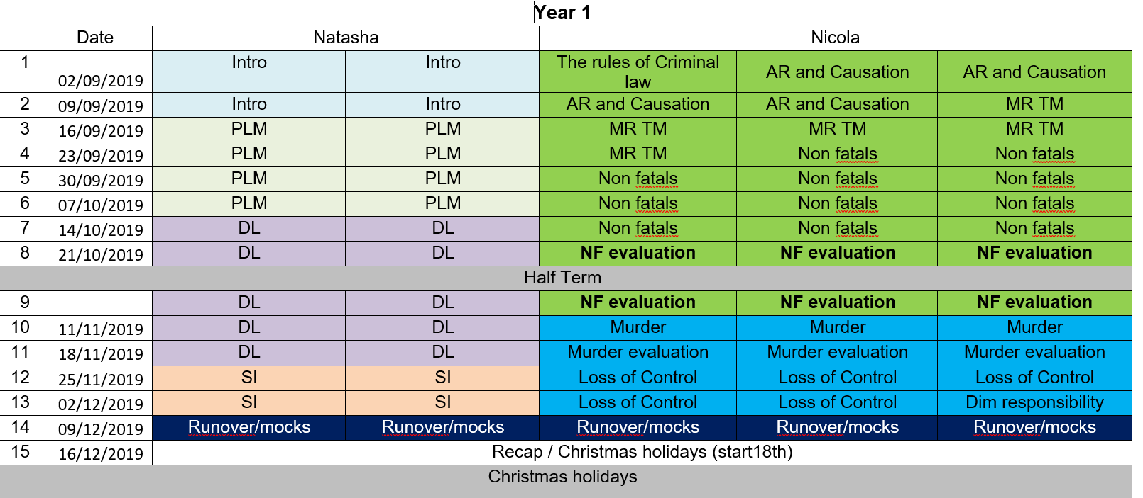
Countdown plan – year 12 (On the website)

Slide 9
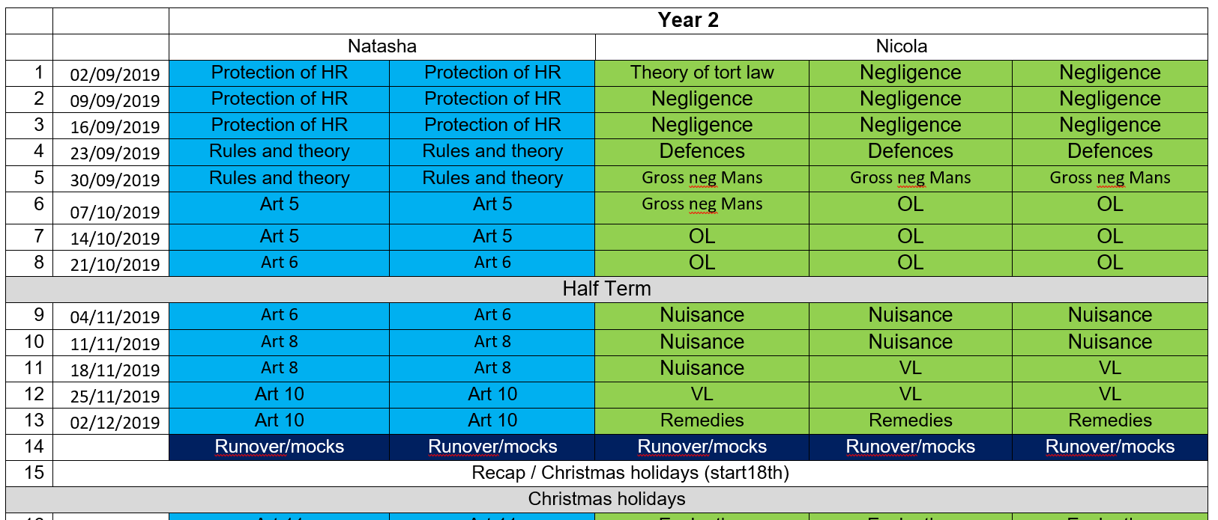
Countdown plan – year 13

Slide 10
Resources
Course Books £18.99 each
OCR A-Level – Hodder Education (Martin/Price/Wortley)
OCR website

Slide 11
Questions??

